Slide 1

The Specialty Food Industry: Opportunity Abounds
Go to Market: Watsonville, CA

Slide 2


Framework for Today
Today’s Topics
  Trends and Industry Drivers
  Study Highlights
  Category Analysis
  Supply Chain
  Retail Landscape
  Future of the Industry
  Q&A
Speaker:
  Ron Tanner, Specialty Food Association
Go to Market: Watsonville, CA
Notes:
Gretchen

Slide 3
The State of the Industry Report
Published each Spring with groundbreaking research from
  Specialty Food Association
  Mintel International Group
  SPINS
Summary Format
  Published in Specialty Food Magazine
Full report available
  Association Members via specialtyfood.com
  Non-Members – contact Mintel directly
Go to Market: Watsonville, CA
Notes:
Gretchen

Slide 4
Trends & Industry Drivers - 1
The specialty food industry is one of the very few that thrived during the recession. As the economy stabilizes, the industry will expand by conquering new channels, redefining upscale, and redefining “better for you at a price you can afford.”
The demand for safer, healthier food continues, creating business for those who can grow consumer trust.
Go to Market: Watsonville, CA
Notes:
DAVID

Slide 5
Trends & Industry Drivers - 2
There are good examples of using social media to promote specialty foods, but for smaller industry participants, the one thing that the big companies can’t copy is personal customer service.
On the to-do list: subscription services (mail or home-delivered), food service, convenience stores, online delivery
Defining or supporting claims for all natural, sustainable, and non-GMO
Go to Market: Watsonville, CA
Notes:
DAVID

Slide 6
Study Highlights - 1
Specialty food in all channels grew at 9.6% in 2012 and 8.0% in 2013
Among the 217 specialty food manufacturers surveyed, average reported annual net profit is 14%
Manufacturers and retailers agree that in sourcing natural/ethical products, all natural and non-GMO items account for the largest share of sales. Sustainable, eco-friendly, and organic are of strong second-tier importance, followed by fair trade.
Go to Market: Watsonville, CA
Notes:
DAVID

Slide 7
Study Highlights - 2
Again in 2014, at the top of the list for future product innovation is gluten free items, followed closely by convenience items. Indulgent products and healthier products rank close together, at third and fourth.
Go to Market: Watsonville, CA
Notes:
DAVID

Slide 8
Study Highlights - 3
What product positioning will grow most in the next 3 years? Retailers say “local”, but manufacturers, importers, distributors, and brokers all place local at 4th-6th out of 7, suggesting opportunities for some.
All agree that non-GMO will grow strongly, and most still believe that all natural will continue to be a leading positioning.
Go to Market: Watsonville, CA
Notes:
DAVID

Slide 9
Study Highlights - 4
Total specialty food industry sales in 2013 topped $88.3 billion
80% of sales are at retail; 20% through foodservice
Specialty food sales increased by 8% in 2013
Between 2011 and 2013, sales of specialty food jumped by 18.4% whereas sales of all food rose by just 5.2%
Go to Market: Watsonville, CA
Notes:
RON

Slide 10
Study Highlights - 5
Cheese and cheese alternatives are the biggest category, at nearly $4 billion
Fastest growing categories are Nut and Seed Butters (+51.6%), Eggs (+35.9%) and Frozen Desserts (+28.2%)
Mainstream supermarkets account for nearly two-thirds of sales, but their share is slipping
Sales at specialty food stores are booming, up 42.4% between 2011 and 2013
Go to Market: Watsonville, CA
Notes:
RON

Slide 11
What was your biggest success in 2013?
Retailer: “Creating a workspace that is fun for my employees who seek to be the best they can be.”
Manufacturer: “Doubling our sales through distributors and trade shows.”
Broker: “New distribution on existing lines.”
Manufacturer: “Selling to a major retailer who has national sales and put our product in almost every store.”
Retailer: “Opening a craft beer gastropub!”
Go to Market: Watsonville, CA
Notes:
RON

Slide 12
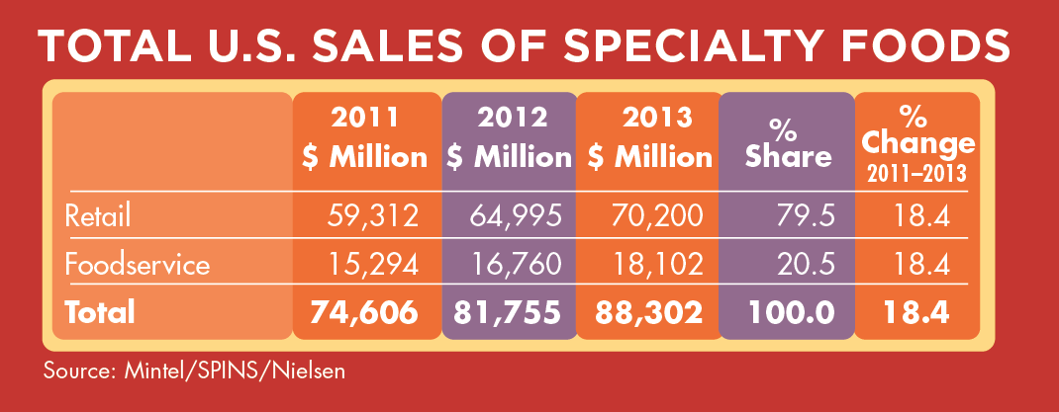
Size of the Specialty Food Market
Go to Market: Watsonville, CA
Notes:
RON

Slide 13
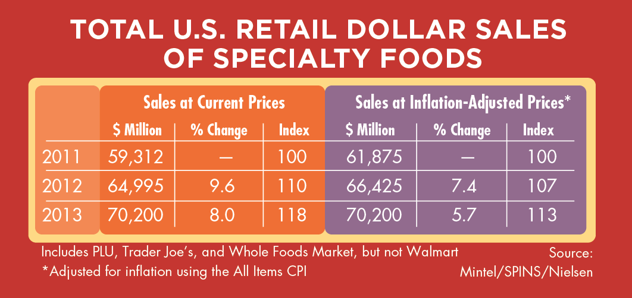
Total Sales of Specialty Foods
Go to Market: Watsonville, CA
Notes:
RON

Slide 14
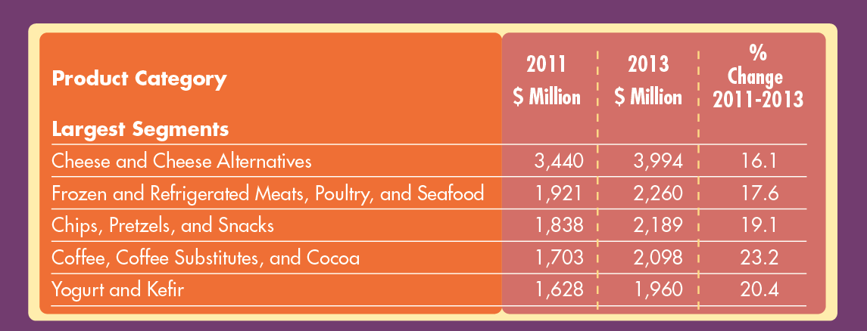
Largest Segments
Go to Market: Watsonville, CA
Notes:
RON

Slide 15
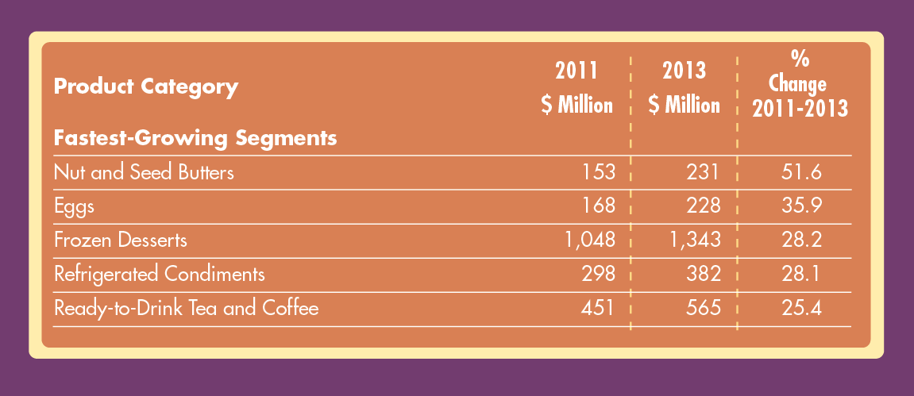
Fastest Growing Segments
Go to Market: Watsonville, CA
Notes:
RON

Slide 16
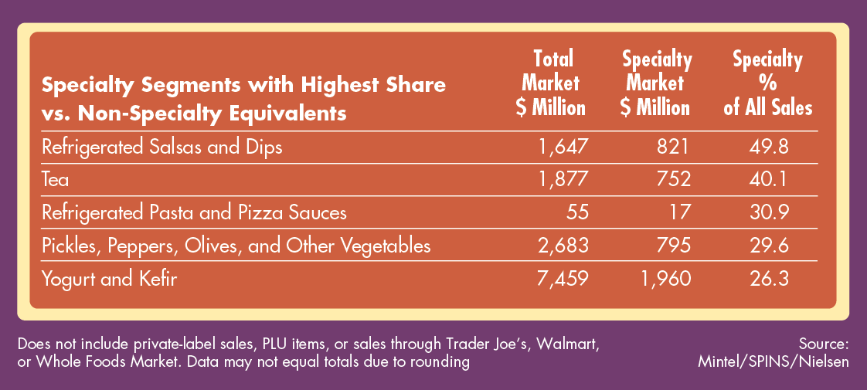
Specialty Segments with Highest Share
Go to Market: Watsonville, CA
Notes:
RON

Slide 17
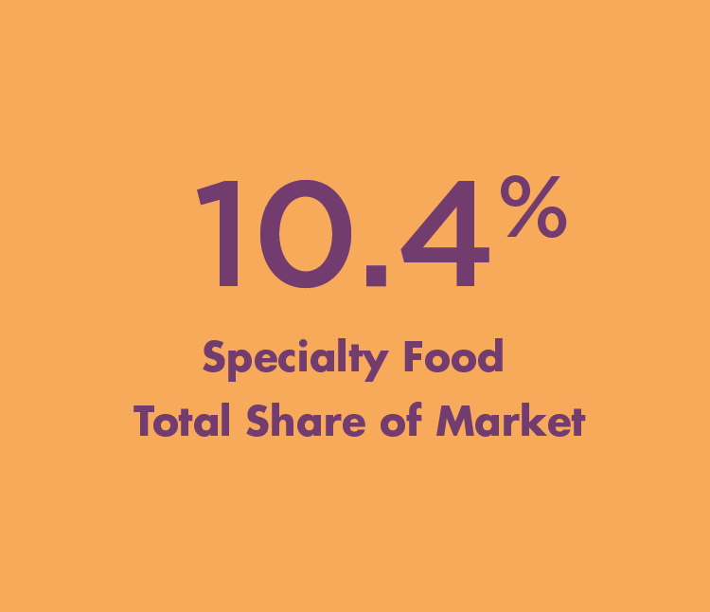
Specialty Food Total Share of Market
Go to Market: Watsonville, CA
Notes:
RON

Slide 18
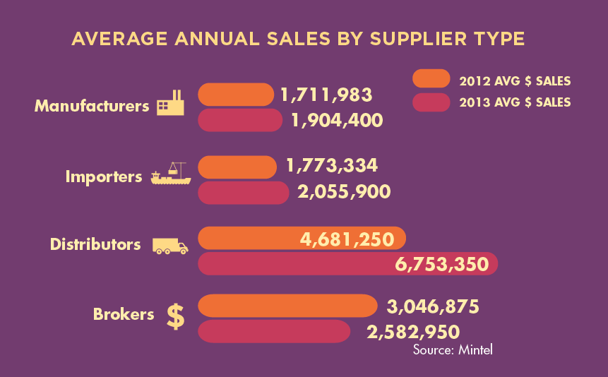
Average Annual Sales by Supplier Type
Go to Market: Watsonville, CA
Notes:
RON

Slide 19
Manufacturers: What are you planning to do differently in 2014?
“More effort into selling and diversifying channels”
“Launch new products that deliver on different need states and usage occasions”
“Introduction of a less boutique, more mainstream variety”
“Harness social media appropriately”
Go to Market: Watsonville, CA
Notes:
RON

Slide 20
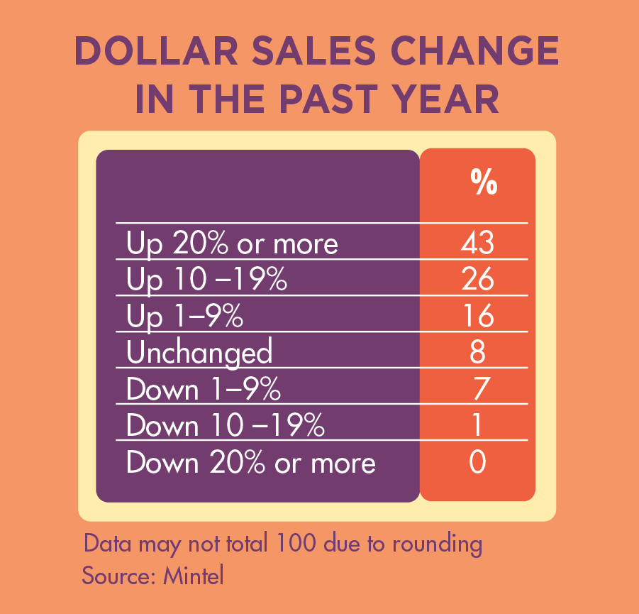
Specialty Food Manufacturers
Average Annual Sales:
$1,904,400
Average # of
SKUs: 41
Go to Market: Watsonville, CA
Notes:
RON

Slide 21
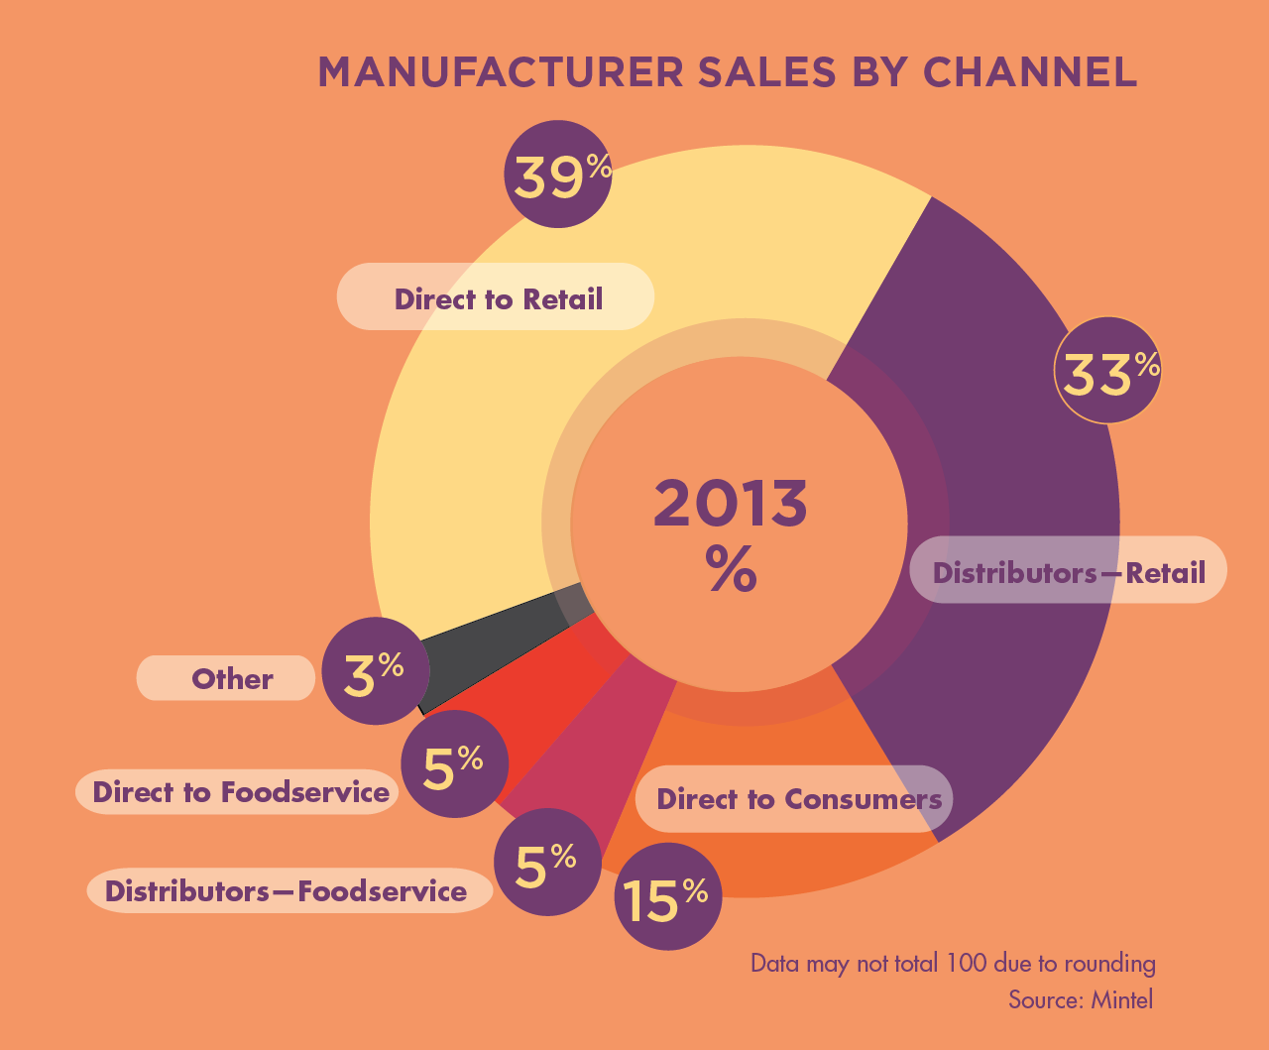
Manufacturer Sales by Channel
Go to Market: Watsonville, CA
Notes:
RON

Slide 22
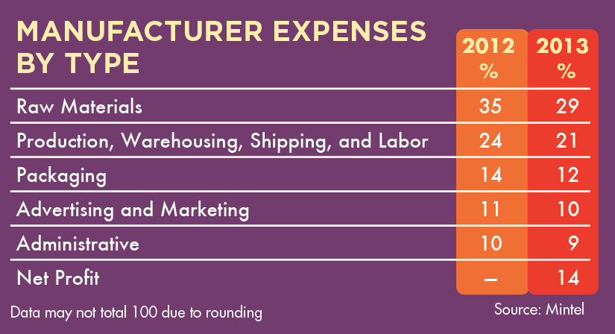
Manufacturer Expenses by Type
Go to Market: Watsonville, CA
Notes:
RON

Slide 23
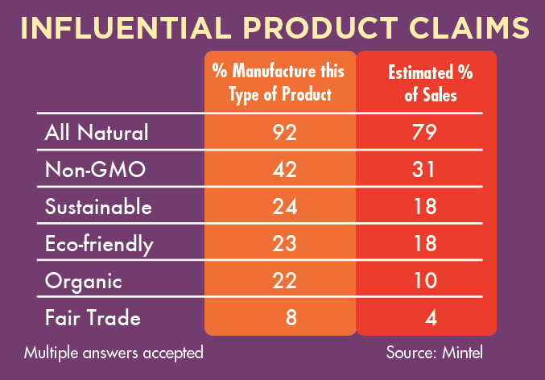
Influential Product Claims
Go to Market: Watsonville, CA
Notes:
RON

Slide 24
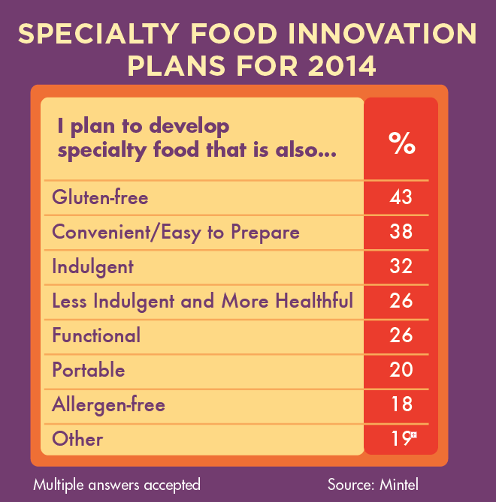
Specialty Food Innovation Plans for 2014
Go to Market: Watsonville, CA
Notes:
RON

Slide 25
Retailers: What is your biggest gripe about the specialty food industry?
“Specialty foods sold in mass-market accounts, like Wal-Mart and Target.”
“Putting sell dates on products that don’t really need them.”
“A lack of loyalty to core retailers from suppliers.”
“Foods that are not fancy or specialty.”
Go to Market: Watsonville, CA
Notes:
RON

Slide 26
Retailers: What are the emerging trends in specialty foods?
“More customers buying ingredients to make a finished product rather than pre-packaged items.”
“Simplicity. Local.”
“Bacon everything, craft chocolate making, hipster packaging.”
“No GMO; prepared food made with less than 5 ingredients.”
Go to Market: Watsonville, CA
Notes:
RON

Slide 27
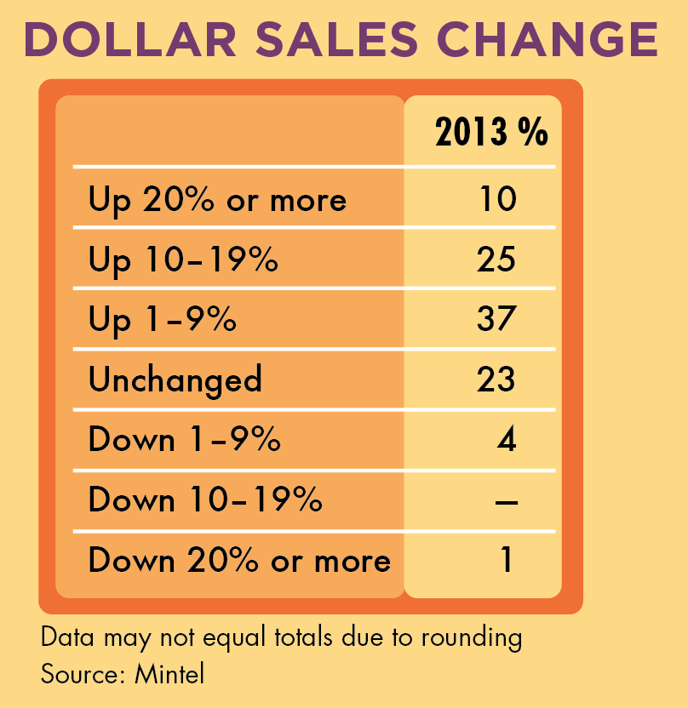
Specialty Food Retailers
Average Annual Sales:
$4.97 Million
Average Sales per Square Foot: $1,045
Go to Market: Watsonville, CA
Notes:
RON

Slide 28
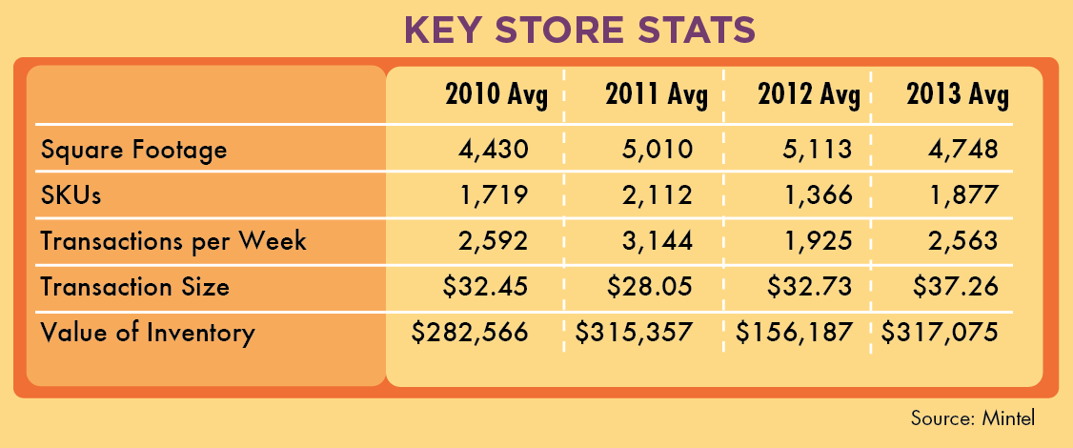
Key Store Stats
Go to Market: Watsonville, CA
Notes:
RON

Slide 29
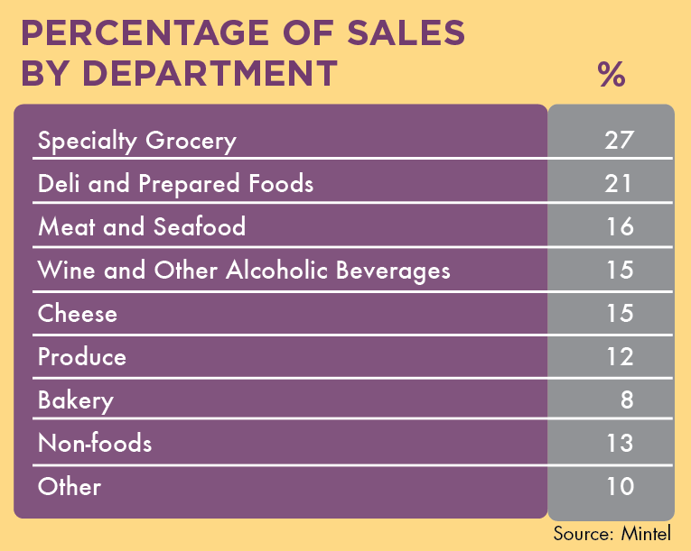
Percentage of Sales by Department
Go to Market: Watsonville, CA
Notes:
RON

Slide 30
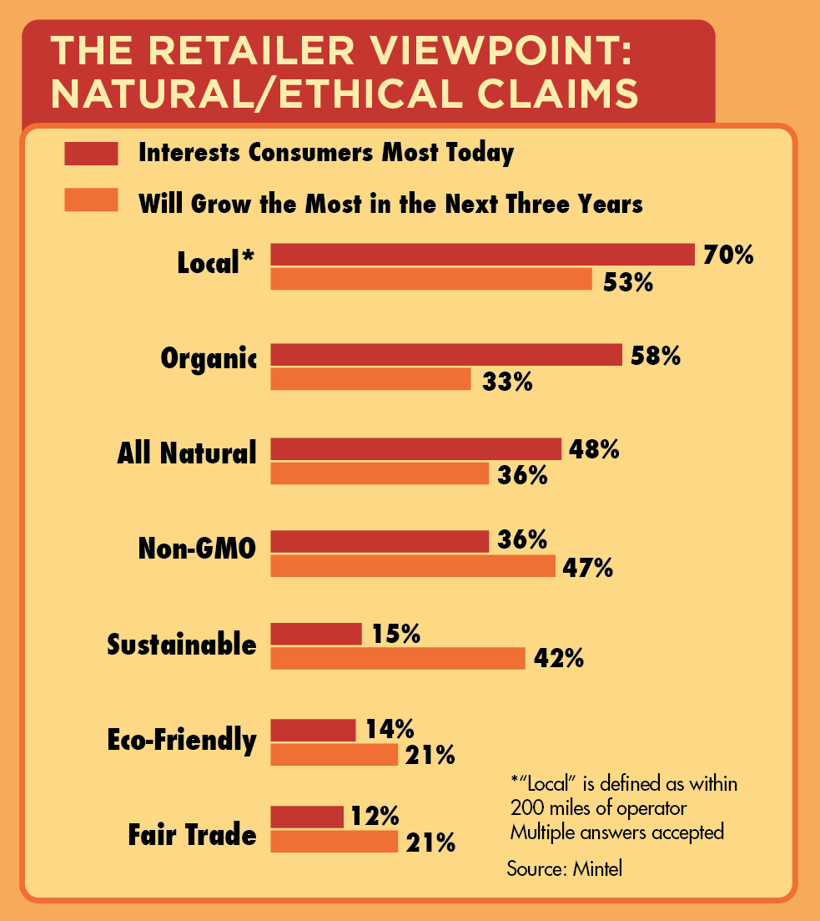
Retailer Viewpoint: Natural/Ethical Claims
Go to Market: Watsonville, CA
Notes:
RON

Slide 31
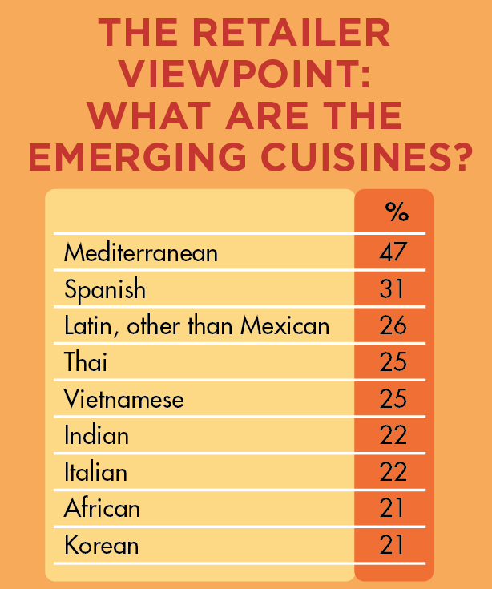
Retailer Viewpoint: Emerging Cuisines
Go to Market: Watsonville, CA
Notes:
RON

Slide 32
In Conclusion
Specialty foods continued to grow in 2013, although at a slightly slower rate than in 2011 and 2012
Specialty food stores and natural food stores are capturing market share at the expense of supermarkets
Local is an important product attribute now and will continue to be for the next three years
2014 looks like another promising year as all segments of the trade strive to improve their businesses
Go to Market: Watsonville, CA
Notes:
RON

Slide 33

Opportunity Abounds: The Specialty Food Association Is Here to Help
Go to Market: Watsonville, CA

Slide 34


What You Should Know About the Specialty Food Association
Not-for-profit trade association established in 1952 with 3,075 member companies
Producers of the Fancy Food Shows, sofi™ Awards, Specialty Food Magazine and specialtyfood.com
Our vision: To be recognized as the innovative hub of the global food and beverage marketplace
  Consumers come to us for new ideas & products that enhance their eating experiences
  Buyers depend on us for new innovations
  Members want us to anticipate their needs and help make them successful
Go to Market: Watsonville, CA

Slide 35
Association History
Established in 1952 by 12 New York City importers as a legislative body
Inaugural Fancy Food Show was presented at the Hotel Astor in New York City in 1955
Primarily an Association of importers through the 1960s, 1970s, 1980s
Now represents all segments, although more than 85% of members are specialty food manufacturers
Go to Market: Watsonville, CA

Slide 36
Specialty Foods are Defined by Quality, Innovation, Style
Specialty Foods are foods and beverages that exemplify quality, innovation and/or style in their category.
Their specialty nature derives from some or all of the following characteristics: their originality, authenticity, ethnic or cultural origin, specific processing, ingredients, limited supply, distinctive use, extraordinary packaging or specific channel of distribution or sale.
By virtue of their differentiation in their categories, such products maintain a high perceived value and often command a premium price.
Go to Market: Watsonville, CA

Slide 37

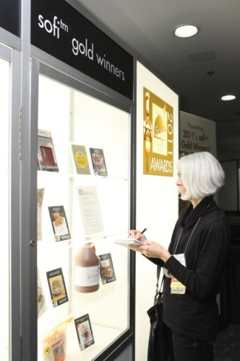
Be Part of the Community of the Specialty Food Association
Showcase your products and network with buyers and peers at the Fancy Food Shows
Connect with other members to learn from your peers
Have your voice heard on legislative and regulatory issues that affect your business
Go to Market: Watsonville, CA

Slide 38
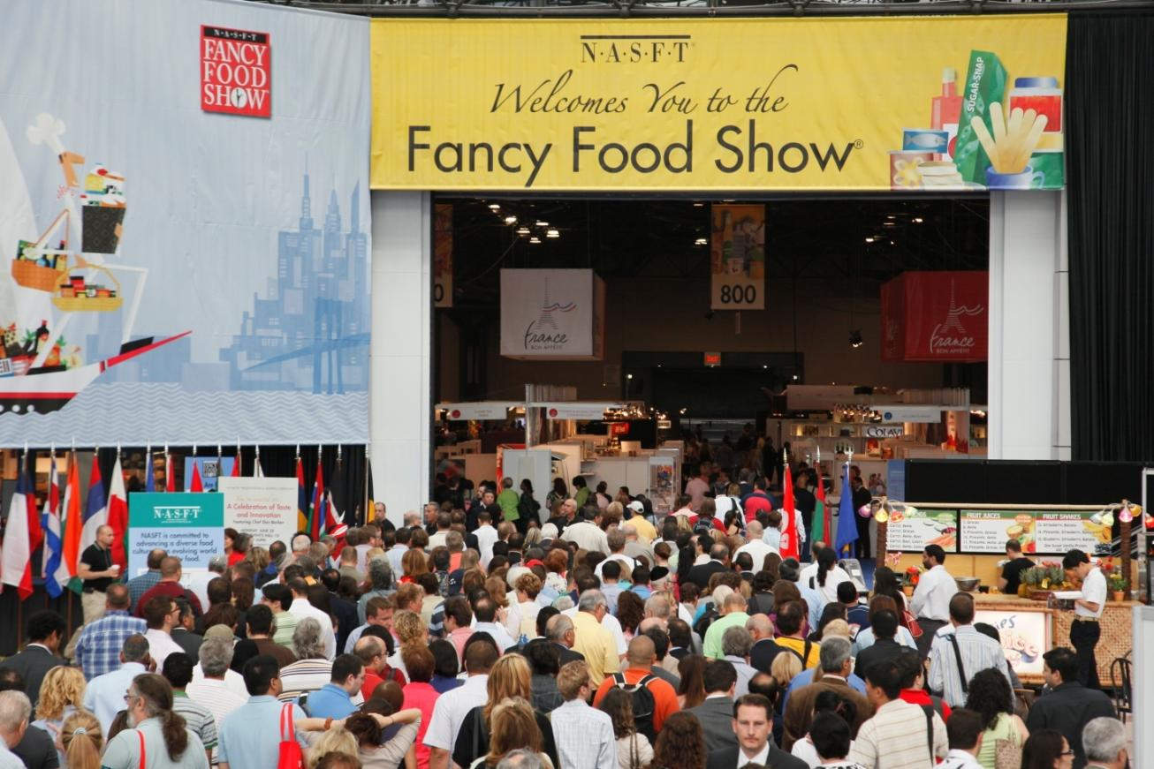
Go to Market: Watsonville, CA

Slide 39
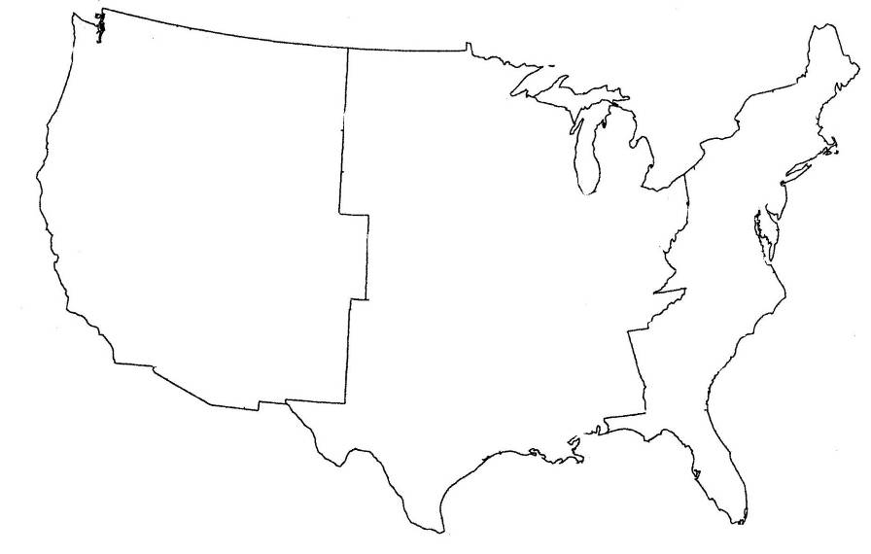
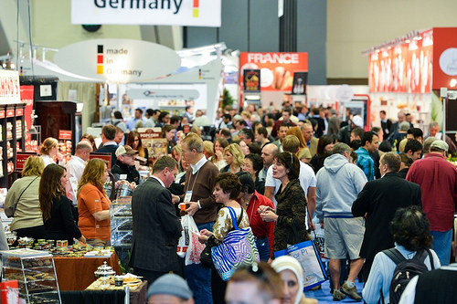

The Fancy Food Shows
Go to Market: Watsonville, CA

Slide 40
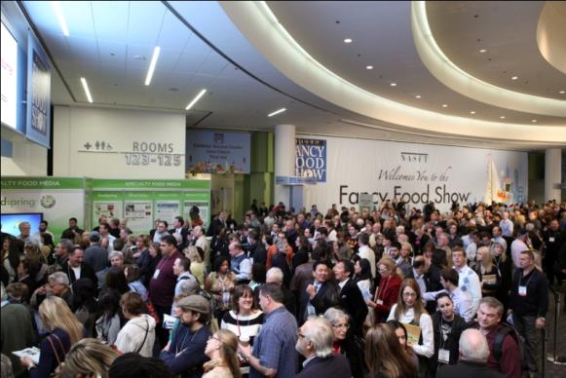
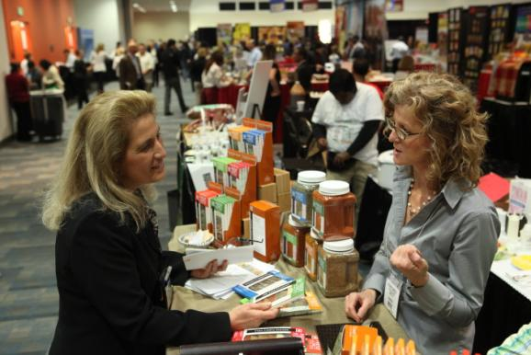
The Fancy Food Shows
North America's premier showcase for specialty-gourmet, natural and organic, foods, snacks and beverages
Some of the best known global brands were launched at The Fancy Food Shows, including Walker‘s Shortbread, Ben & Jerry's, Vitamin Water, Mrs. Fields
Drawing over 35,000 buyers annually
Buying teams serving every major channel attend including Supermarkets, Mass Merchants, Foodservice, Natural & Organic, Gift and Specialty Retail
Go to Market: Watsonville, CA

Slide 41
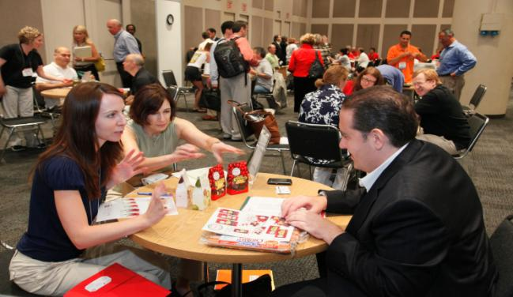
The Fancy Food Show Also Offers…
Opportunities for Connecting to the Industry
Business Builders 1 to 1: Retailer, Distributor and Broker Interview Sessions to connect buyers and sellers BEFORE the Show floor opens
Private Interview Sessions
Learn from industry experts in more than 20 educational seminars
Exciting keynote speakers
Lively networking events
Go to Market: Watsonville, CA

Slide 42


Opportunities Abound…
A value-added program designed to give Fancy Food Show Exhibitors the opportunity to meet key buyers in a private, one-on-one professional setting
  Distributor
  Broker
  Retailer/Foodservice
Go to Market: Watsonville, CA

Slide 43
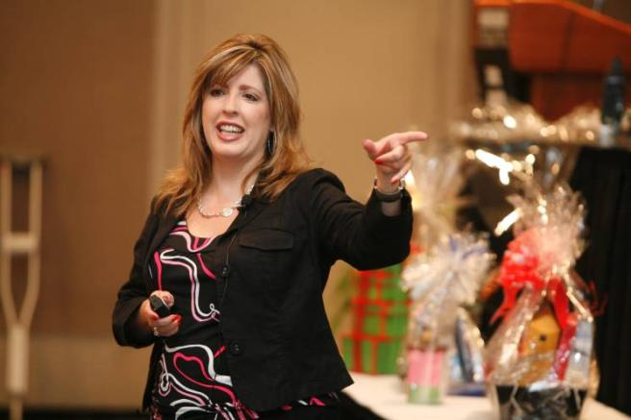

Educating the Specialty Food Industry
Classes begin Saturday, before the Show floor opens
30+ subject matter experts speaking at 20+ sessions for each Show
Reaching over 2,500 people annually
Programming typically includes
  Start-Up Sunday package
  Individual sessions on branding, marketing, social media, trends and other timely business topics
Go to Market: Watsonville, CA

Slide 44
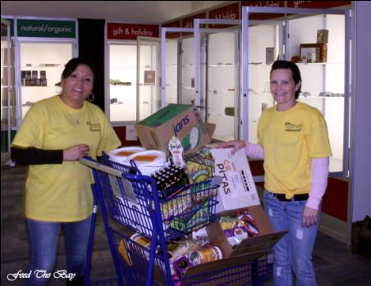
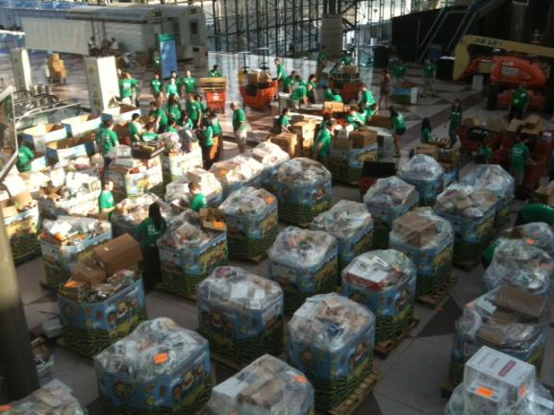

Giving Back: Food Donations
Specialty Food Association Gives Back to the Food Community with Donations Like:
Working with food banks at Show: for example –
200,000 pounds of food donated to City Harvest
$30,000 donation to City Harvest in association with the Summer Fancy Food Show 2013
Go to Market: Watsonville, CA

Slide 45
Fancy Food Show Receives Extensive Press Coverage
    Television
    Good Morning America
    Voice of America TV
    Fox News
  Consumer Websites & Magazines
    Real Simple
    InStyle
    Food Arts
    Food & Wine
    O, The Oprah Magazine
    About.com
    Prevention.com
    CNBC
  Newspapers/Trade Press
    Washington Post
    Houston Chronicle
    Gourmet Retailer
    Gourmet News
    Virginian Pilot
Go to Market: Watsonville, CA

Slide 46

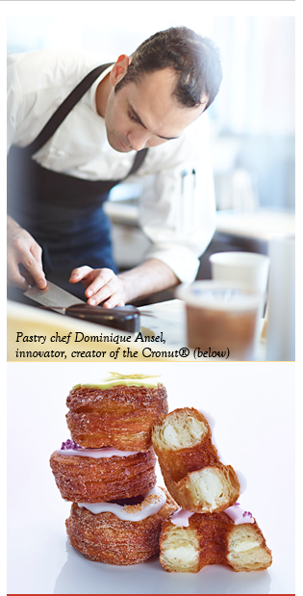


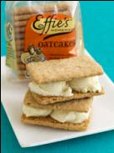
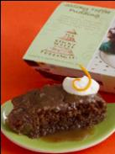

sofi Awards
  2,200 plus entries in 32 categories
  More than 100 million consumer impressions

Slide 47
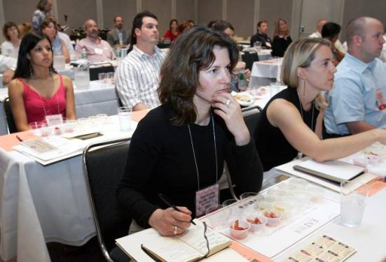
Education Programs Beyond Show
  On Site:
    50+ sessions a year including workshops, seminars, tours and special events
  Online:
    Programs including reference guides, research summaries, guides to industry standards and more
    webinars@work – monthly webinar series also archived for instant replay
    Recordings of onsite sessions for members and others who can not attend Show or are too busy to take classes
  On the Road:
    Education on the move
    Go to Market conferences
    Microfinance sessions
  Always Member-driven content and topics

Slide 48
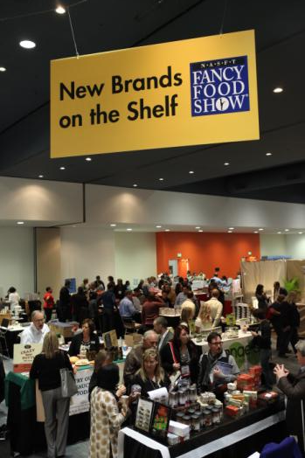
Member Candidate Program
For those who are not quite ready for Exhibiting Membership; provides support needed to succeed and grow a fledgling business
Benefits include:
  Participation in a “New Brands on the Shelf” display at select Fancy Food Shows
  Assistance from a dedicated Specialty Food Association staff person
  Opportunity to network with other Member Candidates
Qualifications
  Be in business for less than one year and/or
  Have fewer than five retail accounts
  Currently have a finished product for resale, meeting labeling criteria (co. name, ingredients, origin)

Slide 49

Industry Research
Research
Annual benchmarking studies:
State of the Specialty Food Industry
- The definitive industry report from Mintel & SPINS
Tracks sales of specialty foods through supermarkets, natural food stores and specialty food stores
Today’s Specialty Food Consumer
Identifies & portrays the specialty food shopper
Who the specialty food consumer is
What product categories they purchase
Demographic and lifestyle preferences
Go to Market: Watsonville, CA

Slide 50
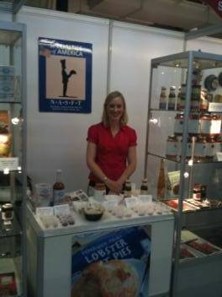

Diversity Program & Travelling Shows
Diversity Program
The Specialty Food Association recognizes the value of Diversity in the Food Industry and is committed to advancing a diverse culture in specialty food.
The Specialty Food Association Diversity program called Focus on Diversity aims to develop and strengthen women/minority-owned companies by providing business building tools
Tools include: research, education and mentoring; plus the opportunity to network directly with potential buyers at our Fancy Food Shows.
Traveling Shows
The Specialty Food Association makes a great effort to help its members reach new markets and launch their export initiatives at an affordable cost
Features shared space pavilions at domestic and international shows such as:
FoodEx, Tokyo, Japan
- London Specialty & Fine Food Fair
- SIAL, Paris
- ANUGA, Cologne, Germany
Go to Market: Watsonville, CA

Slide 51
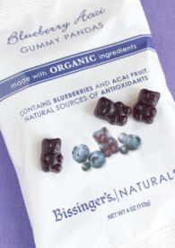
Questions?
Specialty Food Association
136 Madison Avenue
New York, NY 10016
www.specialtyfood.com
Ron Tanner
Vice President, Philanthropy, Government and Industry Relations
rtanner@specialtyfood.com
Go to Market: Watsonville, CA

