Slide 1

CAMEO Microlenders Forum
February 1st, 2017
Hosted by: The San Francisco Federal Reserve

Slide 2
Topics we’ll cover today
Quick background on CRF
Additional small business lending backdrop
Shared challenges facing our industry
Automation broadly
Automation specifically in our context as mission-based lenders
What is SPARK and where can it help my lending operation
Scenarios

Slide 3

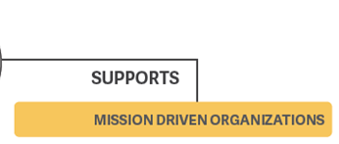
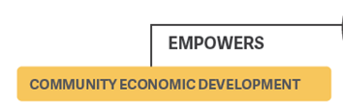

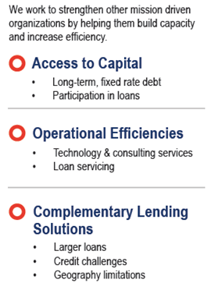
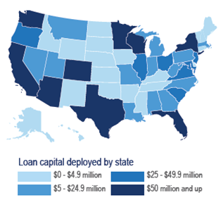
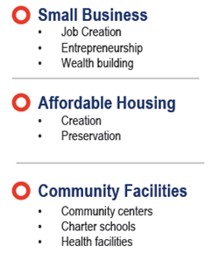
Community Reinvestment Fund, USA (CRF)
Notes:
We developed Spark etc. Talk about who we are overall and why it makes sense that we developed Spark – small business lender needing to increase efficiencies, a commitment to strengthening other mission-driven lenders, we can talk about how we use it every day in later slides.

Slide 4

Measurable, Transformative Community Impact
Improving lives and strengthening communities
^{Our Mission}
^{to improve the lives of} ^{disadvantaged people and} ^{strengthen distressed} ^{communities through} ^{innovative finance.}
^{$2 billion}
⁴⁸
^{1,587}
^{in financing}
^{states and DC}
^{with loans}
^{loans to small businesses}
^{73,000}
^{18,800}
^{1.7 million}
^{jobs created}
^{or retained}
^{affordable}
^{housing units}
^{people served}

Slide 5
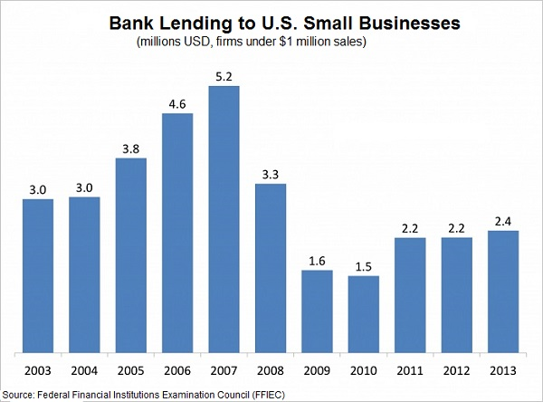
State of small business lending ecosystem
$1.87 Trillion*
Small businesses located in low income communities are key to our economy
Coming out of the great recession, banks evacuated the small business lending space (under $250K)
In this newly created vacuum, online lenders rush in
Micro businesses generate 72% of that revenue
* Source: AEO Big Picture Report – Tammy Halevy - AEO
5
Notes:
5

Slide 6
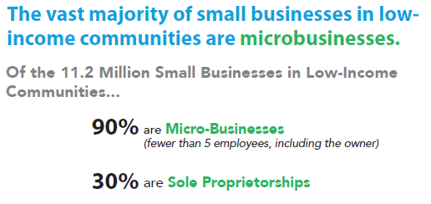
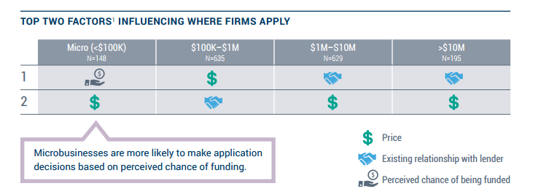
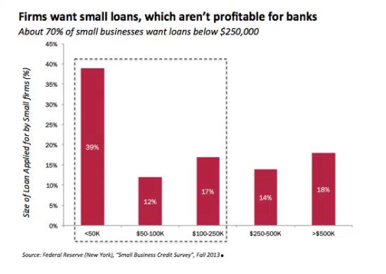


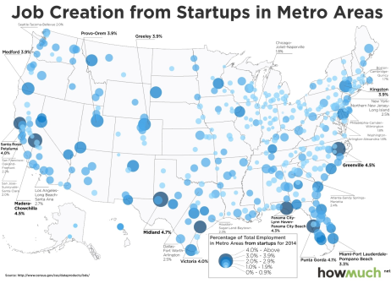
Additional background
Most small businesses in low income communities are micro-businesses *
Micro-business traditionally apply where they have a high chance of being funded (rise of the MCA)**
Small businesses are seeking smaller credits
Banks decline 8,000 small business loan requests per day
Small business startups are even more impactful (and risky)
No knows what a CDFI is, much less how to find one
* Source: AEO Big Picture Report – Tammy Halevy
** Source: 2015 Small Business Credit Survey – Report on Employer Firms
6
Notes:
6

Slide 7




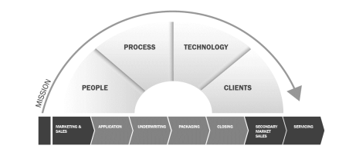
Problem Statement
In our experience, the current mission lending ecosystem suffers from a set of shared challenges:
Borrowers can’t find the lenders
Lack of financial awareness
Inability to provide a quick turn process
People, process, technology, customer experience challenges
Unsustainable inefficiency in the CDFI system
7
Notes:
7

Slide 8








In our work building the capacity of mission lenders, we find:
Manual, paper-based processes
Fund source management
Fragmented Systems Landscape
Inefficient Technology Management
Nascent business intelligence and performance measurement
Stressed servicing and post-closing operations
Staff stretched too thin
Lack of scale

Slide 9






But it’s not all bad! We have strengths too!
Local presence – on the ground
Gap fillers
Responsible and relationship-based
Distributed Network
Business Advisory Services
Regulatory Advantage

Slide 10


Meanwhile, while we’re dealing with all that, some lenders are turning to a secret weapon…
The use of various control systems for operating equipment such as machinery, processes in factories, boilers and heat treating ovens, switching on telephone networks, steering and stabilization of ships, aircraft and other applications and vehicles with minimal or reduced human intervention.
Key phrase: Reduced Human Intervention

Slide 11
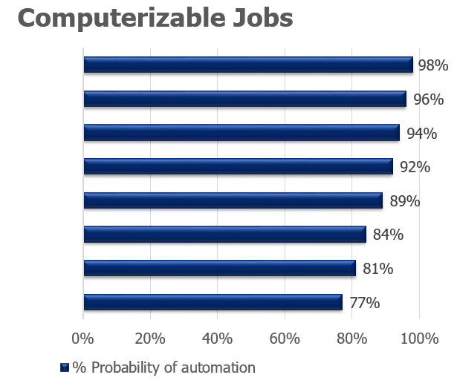
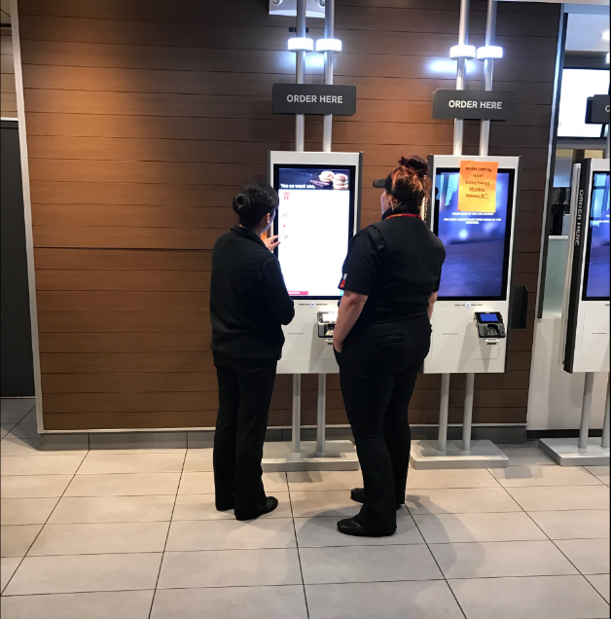






What jobs might we see “automated” in the next 10 years?
Source: The Future of Employment: How Susceptible are Jobs to Computerization (Carl Benedikt Frey and Michael A. Osborne – Sept. 2013)
http://www.oxfordmartin.ox.ac.uk/downloads/academic/The_Future_of_Employment.pdf

Slide 12




What about automation in lending?
What are some examples of things lenders are automating?
Documents
Demographics
Duties
Decisions

Slide 13





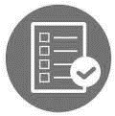


What are good candidates for us to consider automating / outsourcing?
Technology Infrastructure
Customer Acquisition
Process Optimization
New Product Development
Balance Sheet Management
Information Security
Program Compliance
Customer Experience

Slide 14




What kind of road blocks do we often hear?
I’m Comfortable!
I don’t like to Change!
But my way is SPECIAL!
I don’t understand how it works

Slide 15



What if a CDFI created a modern platform to help me automate?
Good News!
We did!
But how?

Slide 16






How did we create this?
Dealt with the naysayers
Raised the capital
Hired the right resources
Managed the project / organizational change
Involved key staff
Counted on change

Slide 17
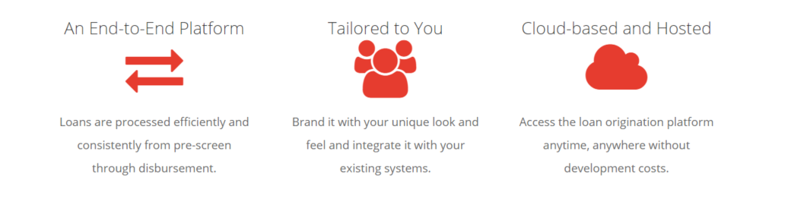
Our Solution
17
Notes:
17
End to End for Loan Origination – everything from pre-screening and credit scoring at the very beginning to final disbursement at the end (and everything in between including loan application, underwriting, forms creation, closing, etc.)
Tailored to you and your organization (your colors, your fonts, your people, etc.)
Cloud based and hosted so there is no internal IT footprint within the organization

Slide 18








Spark Modules
Web Prequalification
Pre-Screen
Application
Underwriting
Forms Creation
Closing
Funding
Config and Admin
18
Notes:
18
Spark modules that exist today

Slide 19
Let’s cover some scenarios
Scenario 1: collecting demographic data automagically
  Scene: borrower has submitted their prequalification information, time to find out more about their location
Scenario 2: scoring a transaction using FICO’s Small Business Scoring Service
  Scene: borrower has submitted their prequalification information, time to learn more about the credit profile of the business and the applicant
Scenario 3: tracking, gathering and naming loan documents
  Scene: borrower has been prequalified, entered some info, time to collect some docs
19
Notes:
19
Spark modules that exist today

