Slide 1
Entrepreneurship Based Economic Development – A Challenge to Micro Business Support Organizations
Dell Gines, MBA, CEcD
Sr. Community Development Advisor
Federal Reserve Bank of Kansas City
The views in this presentation do not necessarily represent the views of the Federal Reserve Bank of Kansas City nor the Federal Reserve System.

Slide 2
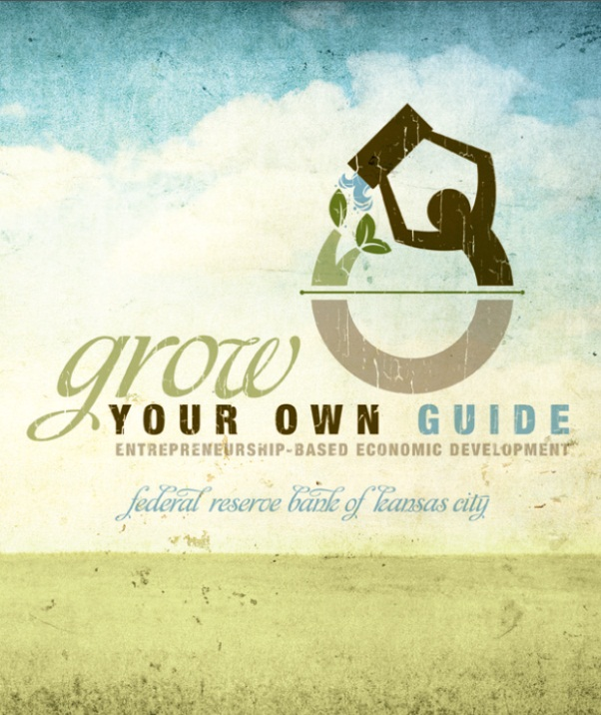
Grow Your Own
At the Kansas City Federal Reserve Bank we are taking a particular interest in entrepreneurship economic development strategy. We feel that entrepreneurship development benefits low to moderate and disadvantage communities in rural an urban environments.
We encourage thoughts and feedback by practicing economic developers as we continue to support our local communities.
The Grow Your Own Guide provides a high level overview of what it takes to conduct entrepreneurship based economic development.
Notes:
We believe that entrepreneurship is a powerful way to reduce poverty, reduce the unemployment rate, build local community economic stability, and grow economies.

Slide 3
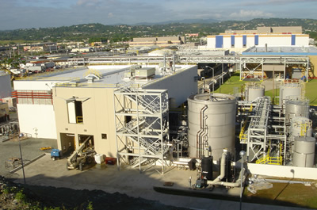
Thinking About Our Future
Attraction based economic development, the dominant form of economic development, simply is not designed, nor effective for addressing the future challenges to economic growth in America.
Notes:
While, attraction based economic development may be useful in some regions, this style of development has been consistently unable to address key issues of development such as urban core poverty and small rural economic decline. In addition, it is not designed to address the issues of the gowing Hispanic population and the need to improve business sizes and total number of business among this population or the needs of the growing senior population.

Slide 4
Thinking About Our Future
“A Times investigation has examined and tallied thousands of local incentives granted nationwide and has found that states, counties and cities are giving up more than $80 billion each year to companies. The beneficiaries come from virtually every corner of the corporate world, encompassing oil and coal conglomerates, technology and entertainment companies, banks and big-box retail chains.” - As Companies Seek Tax Deals, Governments Pay High Price, 2012 (New York Times)
In spite of this massive subsidization we don’t even know if this strategy is working! – The Failure of Economic Development Incentives (2004)
Notes:
The cost of producing one job through microbusiness organizations has been estimated to be far cheaper than the traditional cost of creating a job through attraction and incentive based strategies. $80 billion dollars is a large amount of money that has not been demonstrated to consistently yield positive results across the nation.

Slide 5
WHY ARE SO MANY SMALL BUSINESS ORGANIZATIONS STRUGGLING FOR FUNDING?

Slide 6
Thinking About Our Future
Small business development organizations are victims of:
Small Business Development
Disconnected –Multiple messages, unclear processes, branding difficulties
Traditional Economic Development
Centralized – Dominant message, clear processes, branding clarity
Notes:
Small business development includes both microbusiness organizations, economic garden organizations and any other organization that has as its primary goal to focus on the creation and growth of small businesses.
It is important to create both a SYSTEM and the language of economic development to leverage your way into the economic development space and also the funding streams. To date, the most effective form of business development in this regard is Economic Garden, which came directly out of the economic development space and has always been defined clearly as an economic development strategy.

Slide 7
Economic Development Defined
“Fostering a dynamic environment where economic opportunities can be discovered, taken advantage of and maximized to their fullest extent to create balanced and sustainable economic growth, jobs, a positive sense of ‘place’ and an improved quality of life in a defined geographic region.” – Dell Gines
Notes:
This definition takes into account the importance of place and equity in economic development strategy. The challenges of the growing wealth gap, intractable poverty and other issues needs to be accounted for in the economic development world.

Slide 8
Entrepreneurship Based Economic Development Defined
The systematic support of the creation and growth of small businesses to achieve economic development objectives in a defined geographic region. – Dell Gines

Slide 9
The Five C’s of the Entrepreneurship Ecosystem
The Business Owner
Capital Financial Resources
Connection
Resource & Relationship Network
Culture
The local communities’ perception and support of entrepreneurship
Climate
Regulatory, Economic Development & Policy Environment
Capability
Entrepreneur and Owner Skillset
These must be coordinated and grown through a systematic collaborative system of providers.
Notes:
The 5 C’s were summarized from the reading of a variety of entrepreneurship researchers. I am particularly fond of the work of Daniel Isenberg, Don Macke, Chris Gibbons and Thomas Lyons. These individuals have all done outstanding research on the subject. In addition they are also practitioners who have sought to help communities apply these principles. Daniel Isenberg in particular focuses on ecosystems in America and abroad and has a much more extensive chart categorized slightly different from mine available online at - http://www.forbes.com/sites/danisenberg/2011/05/25/introducing-the-entrepreneurship-ecosystem-four-defining-characteristics/
Thomas Lyons has developed the Triple AAA system of entrepreneurship development, which focuses on size, type and need. Don Macke is the rural entrepreneurship from the Center for Rural Entrepreneurship. He is a great friend of the Kansas City Federal Reserve Bank.
The most important thing to remember is that the 5 C’s actually interact with each other as well as the entrepreneur. For example, the regulatory and policy climate can influence capital sources. Culture can influence connections and networks. When strategizing for development, the develop has to be cognizant of the interactive nature of all the parts and account for how they influence each other.

Slide 10
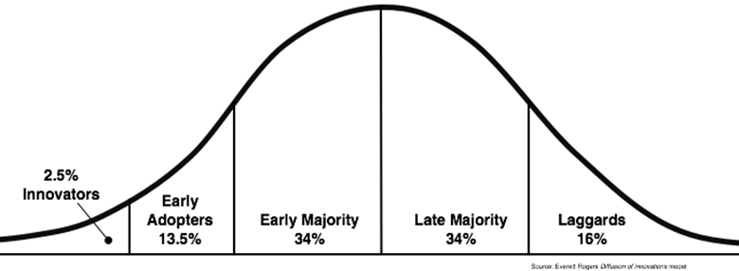
Thinking About Our Future
The Diffusion of Innovation
The Chasm!
Notes:
Right now entrepreneurship based economic development is still in the innovation and early adoption phase. Microbusiness organizations have not embraced it at scale, economic development offices have not embraced it at scale and there is a risk that “THE CHASM” which in diffusion is the place where a critical mass of individuals embrace the strategy and it becomes a normal business practice, will not occur unless we continue to push these models.

Slide 11
Thinking About Our Future
Knowledge
Persuasion
Decision
Confirmation
Implementation
Reject
Accept
Five Stages In The Decision Innovation Process
Notes:
We are essentially at the knowledge phase of entrepreneurship based economic development. We are making strong arguments as to the value of this model to create a competitive America in the long term. The goal is that as more individuals are persuaded to adopt this model that social proof will occur in the economic development world prompting more communities to utilize this strategy.

Slide 12
Thinking About Our Future
The Solutions?
We must unify as institutions
Collaborate deeply both vertically and horizontally
Developing clearly defined systems must be a priority
Reframing our message into the economic development space is essential
Be at the economic development tables and share our voice.

Slide 13
Contact
Dell Gines
Sr. Community Development Advisor
Federal Reserve Bank of Kansas City
dell.gines@kc.frb.org
(402) 221-5606
For more information & resources
http://kansascityfed.org/community/
To sign up for our bi-monthly email please email the address above

