Slide 1
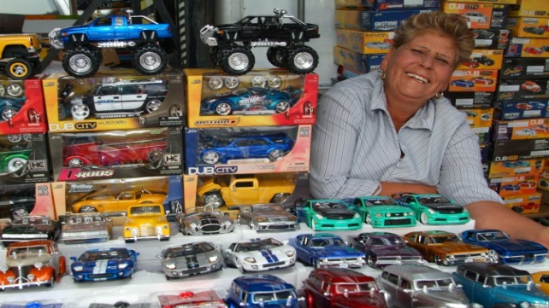
CHANGES TO THE SB LENDING LANDSCAPE & REFERRAL FEES
Gwendy Brown, Opportunity Fund
May 20th, 2014

Slide 2
AGENDA
Trends in the Micro & Small Business Lending Landscape
Referral Fees to Boost Access to Affordable Capital
How You Can Get Involved

Slide 3
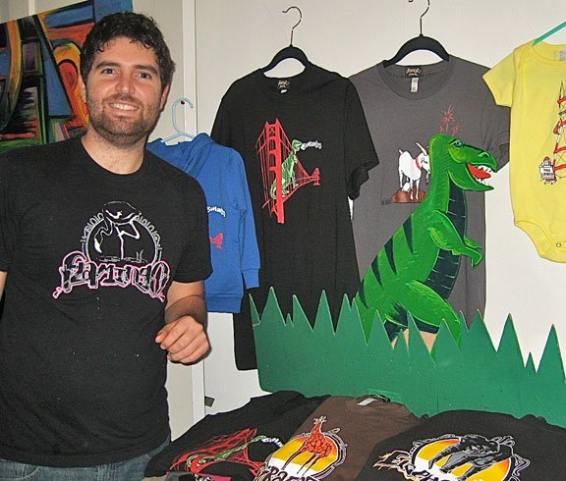
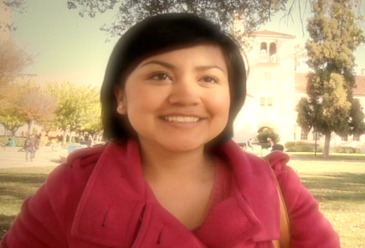
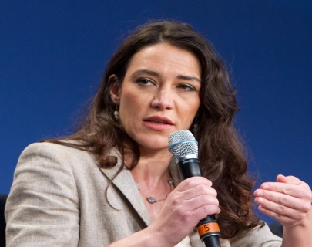
PRODUCTS To ADVANCE ECONOMIC WELL-BEING
Start2Save
$1k savings incentive
Microloans
$2,500-$20k
College Savers
$4k savings incentive
EasyPay & Growth Loans
$20k-$100k

Slide 4
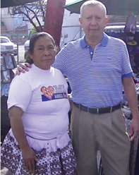
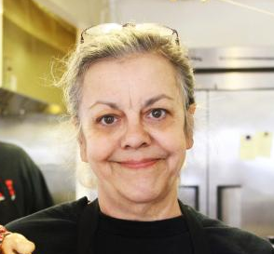
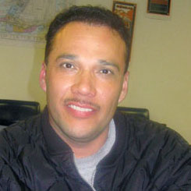
Who do we lend to?
Dora (A) No or limited access to capital | Tina (B) Need for affordable financing | Santos (C) Looking for best alternative financing | Warren (D) Bank loan or other low cost capital
Cash-based microbusinesses or start-up Option: Family or personal loan | Retail or restaurant business Option: Merchant Cash Advance >80% APR, >20% split | Trucking or Mobile food trucks Option: Dealer financing >18% rate | All other businesses Option: Chase Bank

Slide 5
Who do we lend to?
Dora (A) No or limited access to capital | Tina (B) Need for affordable financing | Santos (C) Looking for best alternative financing | Warren (D) Able to access bank or other low cost capital
First “real” loan One-on-one lending Increase in HH income | Rescue businesses already w/ MCA Alternative to MCA | Lower cost of capital Retain $ in the pocket | All other businesses
Segment
How does OF help?
“But for” microlenders, few options for building business and credit exist.
High-cost alternatives can lead to business failure.
Subsidize financing to segments A and B.
Why we target

Slide 6
Segment B Landscape
MCA (Merchant Cash Advance) | Daily ACH | Short-term installment loan | Peer to Peer / Crowd Funding
Split of future credit/debit card sales Fixed % split but payment tied to sales Fixed repayment amount Not a loan | Fixed daily ACH Fixed repayment amount Not tied to sales May or may not be a loan | Gradual/step down installments Fixed monthly payment Fixed total repayment Loan | Fixed monthly payment Simple interest loan
Advance Me/CAN Rapid | On Deck New Logic/CAN | Kabbage | Lending Club Dealstruck
Cash flow (based on credit card sales data) Higher risk borrower | Cash flow (based on bank deposits data) Medium risk borrower | Cash flow (based on shipping data) Medium risk borrower | Mix traditional and cash flow based UW Lower risk borrower
70%+ APR ~ 6 months High out-out-pocket cash | 40-70% APR 12-18 months Medium out-of-pocket cash | 40-70% APR Up to 6 months High out-of-pocket cash | <20% APR >18 months Low out-of-pocket cash
Details
Main Players
Underwriting
Pricing Term

Slide 7
ALTERNATIVE LENDING LANDSCAPE
Size of lending
Opportunity Fund
% APR
MCA
>70%
New Logic
AMI/CAN
55-70%
IOU
On Deck
40-55%
Kabbage
25-40%
Square
PayPal
Amazon
Lending
Club
10-25%
Dealstruck
Up to 6 months
6-12 months
12-18 months
>18 months
Term

Slide 8
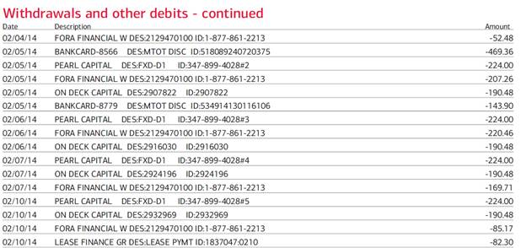
One Client’s Landscape
Bakery in Southern California, 5 years in in business, immigrant owners.
Alt Lender # 1
Alt Lender # 2
Alt Lender # 3
Alt Lender #4:
Merchant Cash Advance taking 20% of credit card sales – not shown on bank statement.
4 Alt Lenders taking out $620 daily from a business with ~ $2,400 average daily sales – not sustainable.
None of the 4 “advances”/loans are reported to the credit bureaus

Slide 9
QUESTIONS FOR AUDIENCE
Have you seen businesses you serve taking on these types of high-cost financing?
Have you seen the businesses you serve being marketed to by these types of companies?

Slide 10
ABOUT REFERRAL FEES
Reaching Underserved:
Word-of-mouth is an important strategy for reaching underbanked immigrant and minority communities.
One key method for reaching potential borrowers is through referral fees to people/businesses who refer successful loan applicants.
Referrers may be local tax preparers/bookkeepers, licensed or unlicensed loan brokers, nonprofits or other business owners who have received a loan.
Referral Fees are Effective:
Alternative lenders and banks commonly use brokers to reach potential customers. For alternative lenders brokers account for upwards of 45% of the financing they do.
Referral fees are paid as a percentage of loan amounts (ranging from 1-1.5% for banks to 5-8% for alternative lenders).

Slide 11
CHALLENGE: UNEVEN PLAYING FIELD
Referral Fees Restricted: CA State Lender’s Law prohibits licensed lenders from paying referral fees to individuals or small businesses that do not have a broker’s license from the State.
Uneven Playing Field:
Most brokers and referrers are not licensed by the state due to high licensing costs.
Alternative lenders structure their products so they are not loans and therefore can freely pay referral fees to anyone.
Microlenders who structure their products to ensure business owners build credit (and comply with state law) can therefore not pay referral fees for a majority of leads.
Because of this uneven playing field, California businesses may not get the best financing available.
Notes:
More about referral fees:

Slide 12
RECOMMENDATION ON REFERRAL FEES
By modifying the California Finance Lenders Law to allow business lenders to pay referral fees to their clients and partners (for successful business loan applications of $5,000 and above), it is possible to harness existing social capital to bring needed affordable financial capital to low income and minority communities.
Notes:
More about referral fees:

Slide 13
QUESTIONS FOR AUDIENCE
Would your organization be interested in earning fees for successful loan referrals to Opportunity Fund?
Would your organization be willing to support (sign on) a bill to modify state lenders law to allow referral fees for business loans of $5,000 and up?

Slide 14
THANK YOU FOR YOUR TIME
Gwendy Brown
Opportunity Fund (408) 516-5688 gwendy@opportunityfund.org

