Slide 1
Big Data Meets Microfinance
Online Microlending, Machine Learning and the Changing Market
Luis Armona and Julia Reichelstein
Stanford University

Slide 2
A Brief Intro to Machine Learning
Supervised machine learning
Algorithms learn from training examples to discover a relationship between input and output variables
Learning is done purely by trial-and-error
No prior knowledge of data required – these algorithms can be used in any field
See Andrew Ng’s CS 229 Stanford course website for an in-depth treatment of machine learning

Slide 3
Framing the Problem
Consider a new MFI with data on 30 previous clients:
X1 : Annual income
X2 : Size of requested loan
The MFI also has data on whether each client paid back the loan or defaulted
Call this output variable Y
Y = 0 if the client paid back the loan (the client was a safe investment choice)
Y = 1 if the client defaulted (the client was too risky)
We will build an algorithm that will take X1 and X2 and calculate a prediction, G

Slide 4
Building the Algorithm
Simplest example – Linear regression: G = a + b*X1 + c*X2
We start with random guesses for the parameters a, b, and c
We make a prediction with these random parameters, then compare the results with the Y values
Our algorithm adjusts the parameters little by little until our predictions, G, match the Y values
We are finding the curve that splits the clients between safe and risky
We can use other equations besides linear – e.g., quadratic, logistic, Gaussian
Often, programmers will try several different equations to find the best one

Slide 5
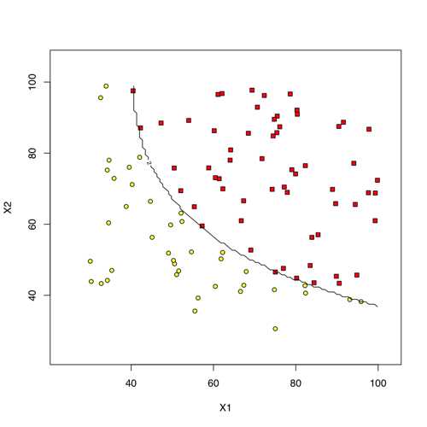
Regression Plot

Slide 6
Should We Be Concerned?
Machine learning is a very powerful tool
However, it cannot replace loan officers – big data algorithms can only complement their work
These algorithms are only as good as their input data
Data collection and processing are key
Algorithms can still be unreliable – loan officers are indispensable for their experience and intuition at these times
Still, machine learning will only get better, and traditional MFIs should take heed
Big data’s infiltration into the market will be gradual but steady – be prepared!

Slide 7
Examples of Automation- Lendup
Pegs loan fee based on following formula: Fee = 15% amount - $0.30*(30 - loan term)
Uses further client info to determine whether they want to disburse the loan
Points System: combines education and loan history with Lendup to increase access to more capital, lower interest, etc.

Slide 8
Examples of Automation- Paypal Working Capital
Uses sales history with paypal to determine terms of loan- NO further information
Requires participants to already use Paypal to process transactions
single fixed fee paid off according to monthly sales
Can take out loan of up to 8% of annual sales revenue.

Slide 9
Examples of Automation- Prosper
Develops Prosper Rating to determine APR faced by borrower
based on credit score, and prosper rating (indicator of expected losses based on type of loan)
Lists loan request in Peer-to-Peer setting for potential investors displaying terms and relevant info for investor

Slide 10
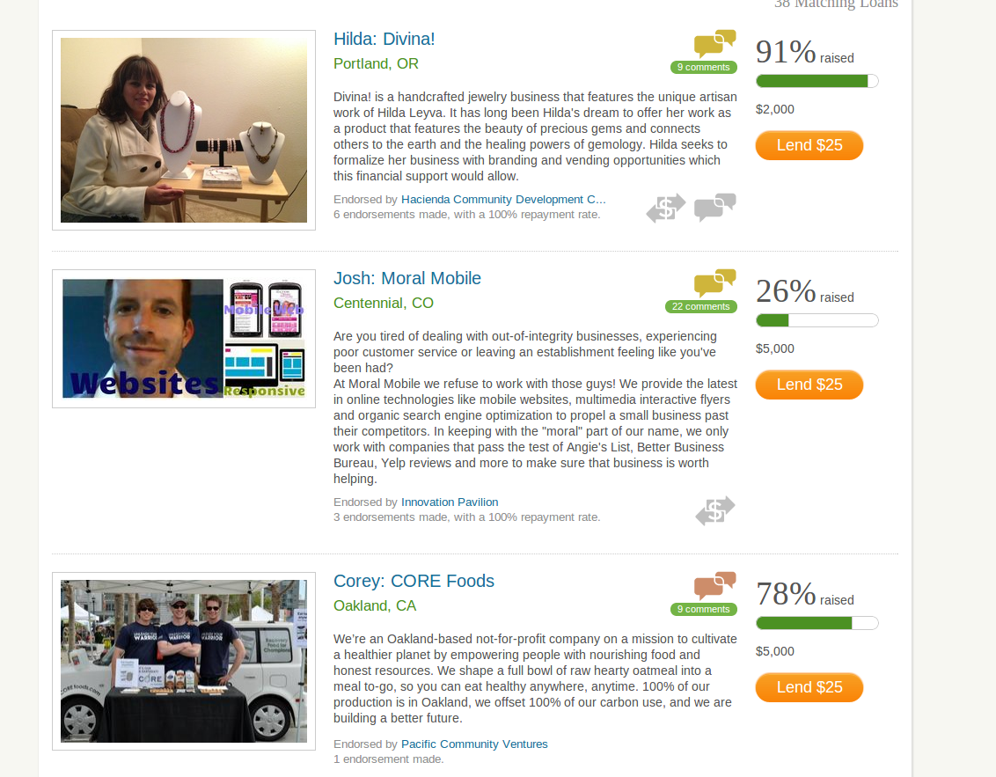
Crowdfunding
Analogous to sites like Kickstarter, but for lending to small businesses
Premier example is Kiva Zip
Extremely lucrative for borrowers: ZERO Percent interest
Taps into intangible “feel-good” benefits for lenders
Requires Trustee, but repayment in USA is only about 85%

Slide 11
Microloan Requirements Data
information of the top players
We took a deeper look into…
Lendup
Sunovis
Kiva Zip
Biz2credit
OnDeck
Kabbage
Paypal Working Capital
Mission Asset Fund
Lending Club
Prosper
Smart Biz
Billfloat
Tiny Cat Loans

Slide 12
Lending Requirements
Credit Score | 67%
Social Security Number | 67%
Business Identification (e.g. address or tax forms) | 58%
Proof of income or business revenue (e.g. bank statements) | 83%
Reference (at least one) | 17%
Collateral | 0%

Slide 13
Comparing Online Lenders to Traditional Lenders- By the Numbers
Online lenders are much younger than traditional lenders- average of 5 years old (compared mean for traditional lenders of 17)
APR: Difficult to measure, but usually much higher
Traditional lender mean: 8% APR; Lendup has APR near 400% for first-time users, despite socially responsible profile
Scale is also massive compared to traditional lenders: Online lenders averaged close to 1 billion $ of loans, compared to 1.2 million $ for traditional lenders
Traditional lenders give out loans typically from $1000 to $50,000, while these online lenders have a much wider range of loans (sometimes as high as $250k)
*Traditional Microfinance lender data based on Microtracker.org California 2012 data
Notes:
while traditional microlenders are community-focused, online lenders have no problem charging an APR north of 100% . Difficult to measure because of diverse loan products (offer initial fees plus interest, sometimes only a fixed fee, etc.) Our sample of lenders online have issued far more loans in $ terms than the trad members

Slide 14
Conclusion
Big Data makes lending decisions a simple but potentially flawed routine
Allows for massive economies of scale
Customer faces simple and user-friendly interface
Online lenders focus on easily quantifiable data with valuable information (i.e. credit scores)
Offerings and form of loan product differ from firm to firm
P2P vs Fixed Fee vs Other formulas
Traditional microlenders are more limited in their consumer base, but usually offer much friendlier APR due to community-oriented approach

