Slide 1
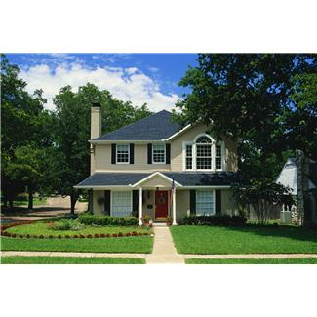


COTTAGE FOOD
Environmental Health Division
Los Angeles County Department of Public Health
Notes:
1
1

Slide 2
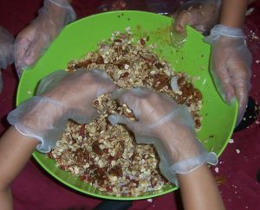
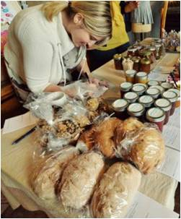
California Homemade Food Act (AB 1616)
Effective January 1, 2013
Approved non-potentially hazardous foods (“cottage foods”) to be made in registered or permitted private homes
Notes:
The law began in 2011, when a home bread baker in Los Angeles was closed by Environmental Health staff. He had been preparing bread in a brick oven in the backyard of his home, then sold the bread to local food markets. Our staff had been alerted to his business enterprise by an article in a local newspaper that featured his business.
When Assembly Member Mike Gatto heard about the bread bakers’ home-based business and the circumstances of the closure, he joined in the bread bakers’ plight and introduced Assembly Bill 1616, which aimed to change the California Retail Food Code to allow certain foods to be prepared in home kitchens.
Increase opportunity for entrepreneur development to prevent poverty and hunger, and strengthen local economies.
Increase opportunity for low-income and rural communities to purchase healthy foods
Improve health conditions that are preventable and curable through lifestyle choices including consumption of healthy food.
2

Slide 3

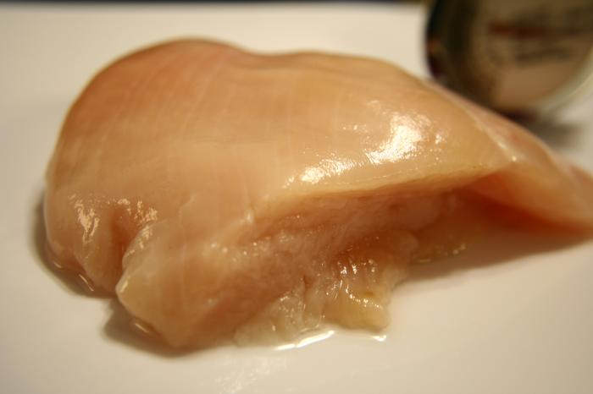
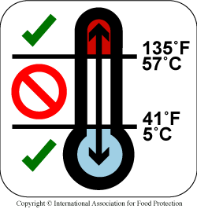

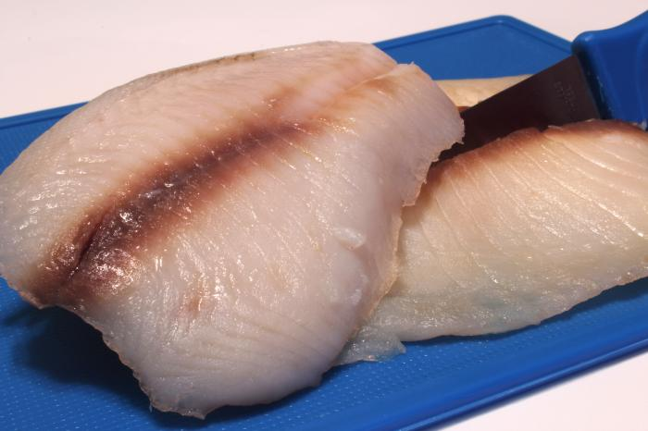
POTENTIALLY HAZARDOUS FOOD
Food that requires time or temperature control
Animal origin
Plant origin that is heat-treated
Raw seed sprouts, cut melons cut tomatoes; garlic in oil mixtures
Notes:
3
Potentially Hazardous Foods
means a food that requires time or temperature control to limit pathogenic micro-organism growth or toxin formation.
animal origin that is raw or heat-treated,
a food of plant origin that is heat-treated or consists of raw seed sprouts, cut melons, cut tomatoes or mixtures of cut tomatoes that are not modified to render them unable to support pathogenic micro-organism growth or toxin formation, and garlic-in-oil mixtures that are not acidified or otherwise modified at a food processing plant in a way that results in mixtures that do not support growth or toxin formation as specified under subdivision (a).
"Potentially hazardous food" does not include any of the following:
(1) A food with an aw value of 0.85 or less.
(2) A food with a pH level of 4.6 or below when measured at 75°F.
(3) An air-cooled, hard-boiled egg with shell intact, or an egg with shell intact that is not hard-boiled, but has been pasteurized to destroy all viable salmonellae.
(4) A food in an unopened, hermetically sealed container that is commercially processed to achieve and maintain commercial sterility under conditions of nonrefrigerated storage and distribution.
(5) A food that has been shown by appropriate microbial challenge studies
3

Slide 4



Cottage Food Products
California Department of Public Health
- add or delete food from the approved list
- list available on the website
Notes:
4
4

Slide 5
Cottage Food Products
Baked goods w/o cream, custard or meat fillings | Chocolate covered nonperishable foods (nuts & dried fruit) | Fruit: pies, empanadas & fruit tamales
Honey & sweet sorghum syrup | Herb blends & dried mole paste | Granola, cereals, trail mixes
Roasted coffee and dried tea | Nut mixes and nut butters | Jams, jelly, preserves, and fruit butter
Dry baking mixes | Dried Pasta | Dried Fruit
Popcorn | Vinegar & mustard | Waffle cones/pizelles
Notes:
5
5

Slide 6
Local Ordinances
A city, county, or city and county shall not prohibit a CFO in any residential dwellings but shall do one of the following:
  Classify a CFO as a permitted use of residential property for zoning purposes
  Grant a nondiscretionary permit to use a residence as CFO that complies with local ordinances
  Require any CFO to apply for a permit to use a residence for its operation
Notes:
51035. (a) A city, county, or city and county shall not prohibit a cottage food operation, as defined in Section 113758 of the Health and Safety Code, in any residential dwellings, but shall do one of the following:
(1) Classify a cottage food operation as a permitted use of residential property for zoning purposes.
(2) Grant a nondiscretionary permit to use a residence as any cottage food operation that complies with local ordinances prescribing reasonable standards, restrictions, and requirements concerning spacing and concentration, traffic control, parking, and noise control relating to those homes. Any noise standards shall be consistent with local noise ordinances implementing the noise element of the general plan. The permit issued pursuant to this paragraph shall be granted by the zoning administrator, or if there is no zoning administrator, by the person or persons designated by the planning agency to grant these permits, upon the certification without a hearing.
(3) Require any cottage food operation to apply for a permit to use a residence for its operation. The zoning administrator, or if there is no zoning administrator, the person or persons designated by the planning agency to handle the use permits, shall review and decide the applications. The use permit shall be granted if the cottage food operation complies with local ordinances, if any, prescribing reasonable standards, restrictions, and requirements concerning the following factors: spacing and concentration, traffic control, parking, and noise control relating to those homes. Any noise standards shall be consistent with local noise ordinances implementing the noise element of the general plan. The local government shall process any required permit as economically as possible. Fees charged for review shall not exceed the costs of the review and permit process. An applicant may request a verification of fees, and the city, county, or city and county shall provide the applicant with a written breakdown within 45 days of the request. The application form for cottage food operation permits shall include a statement of the applicant’s right to request the written fee verification.
6

Slide 7
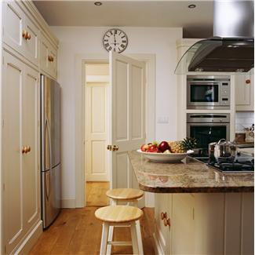
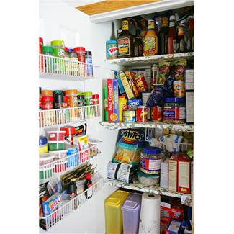
Registered Or Permitted Area
A portion of a private home that contains the private home’s kitchen
Attached rooms within the home that are used exclusively for storage
Notes:
7
A portion of a private home that contains the private home’s kitchen used for the preparation, packaging, storage, or handling of cottage food products and related ingredients or equipment, or both, and attached rooms within the home that are used exclusively for storage.
A dwelling, including an apartment or other leased space, where individuals reside
7

Slide 8

CFO Requirements & Limitations
Not to exceed the gross annual sales amount:
2013 | $35,000
2014 | $45,000
2015 | $50,000
Notes:
8
8

Slide 9

CFO Requirements
Meet the registration or permitting requirements
Prepare only foods on the approved list
Label cottage food products in accordance with the state and federal regulations
Meet the food preparation and sanitation requirements
Notes:
9
Paid or volunteer, who is involved in the preparation, packaging, handling and storage
Works for the CFO
One full time equivalent employee, excluding family members
9

Slide 10
Types of CFO
Notes:
10
10

Slide 11

Class A CFO
Registration with Environmental Health
Self-certification checklist required
No initial inspection; complaint basis only
Notes:
11
11

Slide 12
Class A CFO
CLASS A
Direct Sales
Direct Purchase
Holiday bazaars Temporary events
Bake sales Food swaps
Farm stands Certified Farmers’ Market
Community-supported agriculture subscriptions
Notes:
12
Direct Sales means a transaction between a cottage food operation operator and a consumer, where the consumer purchases the cottage food product directly from the cottage food operation.
12

Slide 13

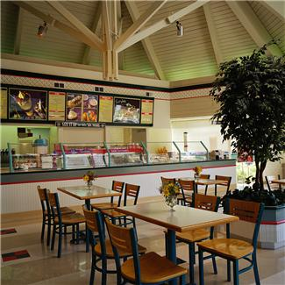
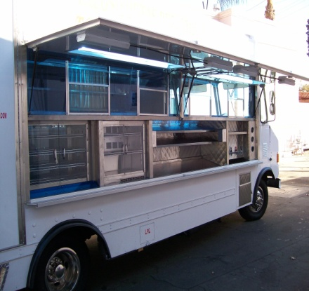
Class B CFO
Registration with Environmental Health
Public Health Permit issued
Inspections:
  Initial - prior to issuing PHP
  Annual
  Complaint basis
Notes:
13
13

Slide 14
Class B CFO
CLASS B
Direct Sales
Direct Purchase
Holiday bazaars Temporary events
Bake sales Food swaps
Farm stands Certified Farmers’ Market
Community-supported agriculture subscriptions
Indirect Sales
Licensed Foond Facilities
Notes:
14
Indirect sale means an interaction between a CFO, a third-party retailer, and a consumer, where the consumer purchases the cottage food products made by the CFO from a third-party retailer that holds a valid permit.
14

Slide 15
LABELING REQUIREMENTS
Notes:
15
15

Slide 16
Class A CFO (Primary display panel)
Made in a Home Kitchen
Walnut cookies
REAL GRANDMA llC.
1 ABC Street, Unit A,
Los Angeles, CA 90000
Registration #: LA19A130000
L.A. COUNTY
Ingredients: Enriched flour (wheat flour, niacin, reduced iron, and folic acid), walnuts, sugar, eggs, salt, vanilla extract, and baking soda.
Contains: Wheat, eggs, milk and walnuts
Net Weight: 8 oz. (226.8grms)
Notes:
16
16

Slide 17
Class B CFO (Primary display panel)
JOE’S HEALTHY FRUIT MEDLEY PIE
Permit Number: 123456
County of Los Angeles
Bo Joe Jr.
101 Main Street,
Calabasas 91301
Ingredients: Flour (wheat flour, niacin, iron and folic acid),
Sugar (brown/white), currants, apple, walnuts, blackberries,
cherries, vanilla, cornstarch, salt and water.
Contains: Wheat, walnut
Made in a Home Kitchen
Net weight: 12 oz (340.19 g)
Notes:
17
17

Slide 18
Class B CFO (Primary display panel)
Best Blend of Calming Tea
SUPER TEA BLEND
Stress Busters Company (John Joe)
1234 Boulevard St.,
Los Angeles County: 3600-123456
Ingredients: Tea blend (chamomile, lavender, ashwaga, California poppy, valeria root, lemon balm, rhodiala and kava)
REPACKAGED IN A HOME KITCHEN
Net weight: 1 lb.
Notes:
18
18

Slide 19

Class B CFO (White Pages)
Homemade Delicious Corn Tortilla
Lancaster, California 93534
Permit Number: 123456
County of Los Angeles
Ingredients: Milk, Flour, Cornmeal, Egg, Water, Salt
Lovingly Made in a Home Kitchen
Net weight: 12 oz (340.19 g)
FISHERMAN’S KITCHEN
Jane Doe Sr.
Notes:
19
19

Slide 20

Class B CFO
Without label or packaging and sold in licensed food facilities
Identify to consumer as homemade on the menu, menu board, or other location that would inform a consumer of its homemade status
Today’s Special: $10
Carne Asada with homemade tortilla
Chicken Wrap with fresh veggies and homemade raspberry preserves
Notes:
20
20

Slide 21

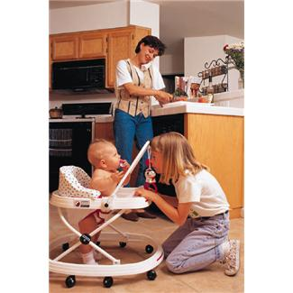
Operational Requirements
No domestic activities
No infants, small children or pets
No vermin or insect infestation
Food storage
Clean, maintained in a good repair
Wash, Rinse, Sanitize
Water supply and drainage
Smoking prohibited
Person with contagious illness
Notes:
21
21

Slide 22
Minor amendments to the Cottage Food Law AB 1252 starting January 2014
A new bill (AB 1252) has now been signed by the governor.
Clarifies that Class A & B operations can do direct sales anywhere within the state (Class B still limited to indirect sales within their counties and others that allow it).
Class A operations will be required to list their county on their label.

Slide 23
Website
http://publichealth.lacounty.gov/eh
Class A
Plan Check: (626) 430-5560
Class B
Food & Milk: (626) 430-5400
Notes:
23
23

Slide 24
Questions?
Notes:
24
24

