Slide 1

Introduction to the Catholic Campaign for Human Development (CCHD) and the National Catholic Rural Life Conference (NCRLC)
CCHD provides funding to groups of low income people who are empowered to address the causes of poverty in their communities
More than 8,000 grants have been awarded to rural and urban groups to seek justice and lasting change
Grants are focused in two areas: Community Development and Economic Development
National Catholic Rural Life Conference is partnering with CCHD to expand outreach and consulting services to promote strong applications addressing rural poverty

Slide 2
About CCHD
Created in 1970, CCHD is the domestic anti-poverty, social justice program of the United States Conference of Catholic Bishops (USCCB).
CCHD’s mission is to address the root causes of poverty in the United States through promotion and support of low-income controlled Community Organizing and Economic Development initiatives and through transformative education in non-low-income communities.
CCHD is rooted in the gospel call to “bring good news to the poor, liberty to the captives, new sight to the blind, and to set the downtrodden free” (Luke 4:18-19a)

Slide 3
About NCRLC
Founded in 1923, our mission is to apply the teachings of Jesus Christ for the social, economic, and spiritual development of rural America with responsibility for the care of God’s creation.
NCRLC Program Areas:
  Rural Outreach/Ministry
  Stewardship of Creation
  Agriculture and Food
  * Current topics include: the Farm Bill, food & farm worker justice, caring for the earth, pastoral support, and lay leadership. Read more on our website!

Slide 4
Outreach/Consulting Services
Goal: Increase the number of successful grant applications from rural communities to address poverty
Outreach: targeted outreach in 40 dioceses in 15 states with high rural poverty and key NCRLC contacts
Strategies: phone, email, PSA’s, Catholic newspapers, conference calls, diocesan websites, articles featuring CCHD rural success stories, and NCRLC media: website, e-bulletin, and Catholic Rural Life magazine
Consulting: email, phone, conference calls, etc. to screen project ideas, review proposal process, highlight best practices, link to resources, review draft applications

Slide 5
Types of Projects Funded by CCHD
Community Organizing
* Topics include: environmental justice, farm labor issues, immigrant rights, senior issues, education, crime/safety, etc.
Economic Development
* Topics are focused in five categories:
  Real Estate – land trusts, cooperatives
  Business Incubators and Marketplaces
  Community Development Financial Institutions – credit unions, loan funds, community banks
  Social Purpose/Training Businesses
  Worker Owned and Community Owned Businesses

Slide 6
Economic Development
Projects under this category seek to foster human & economic development by:
Developing Alternative Economic Structures (Economic Development Institutions)
Creating Living Wage jobs or other assets
Engaging low-income people to participate in decision making & benefit from asset development
Benefiting larger communities

Slide 7
Economic Development Criteria
Does not contradict Catholic Teaching and does not do business in a partisan way
Will create income, jobs and/or assets for low income people and communities
One-third of those who plan, implement, and make policy for the applicant organization (board of directors or project board) are low income
One half of the intended beneficiaries from the EDI must be low income (80% HUD Area Median Income)
Leaders must be involved in training and development
1:1 Cash matching funds are committed to the request for CCHD funds (Grant range between $25,000 - $75,000)
Must have a comprehensive Business or Strategic plan for 3-5 years

Slide 8
Not Eligible for Economic Development Grants
Projects owned or controlled by governmental agencies (federal, state, or local) or educational bodies
Projects focused on direct service (e.g. business consulting, financial literacy, savings programs, homeownership education programs by themselves are not eligible)
Projects focused on sole proprietorships, simple partnerships, or fee simple housing projects
Projects with fiscal agents
Projects intending to re-grant CCHD monies

Slide 9
Economic Development Program Areas
Business Incubators/Marketplaces - provide a facility, peer network, and ongoing support for small business development. Marketplaces emphasize developing a growing base of customers in one shared location.
Community Development Financial Institutions - such as community development credit unions, loan funds, and community banks help low-income people, community-based organizations, and businesses by providing financing for community development.
Worker-Owned and Community Owned Businesses - have ownership and organizational structures that create both income and assets for low-income people. Ownership may be held by workers, a community-based organization, or in a form that combines both.

Slide 10
Economic Development Program Areas
Real Estate - They may be for housing, business, commercial, or industrial uses. Legal structures, like community land trusts or limited equity cooperatives, are used to balance asset ownership and ongoing decision-making.
Social Purpose Training - their focus is on the development of a business that has an integral, on-the-job training component that may open up the possibility of placement in other mainstream businesses once workers have acquired certain skills.
Companion Elements – CCHD looks for capacity building, leadership development, partnerships, and a fundraising strategy as well a 3 - 5 year strategic plan or business plan to support the project.

Slide 11
Outcomes
CCHD is looking for at least 10 living wage jobs or affordable loans targeted at low income people
Individual assets – generate income, loan to start/expand a business or improve a home
Community assets – marketplace to access products, loan pool to improve the community, community business (provides jobs, services)
Involvement of low income people in creating and sustaining economic growth in their communities

Slide 12
Uses of CCHD Funding
Staff – permanent, seasonal, FT/PT
Capacity building – financial systems, board training, leadership development, technical assistance
Overhead expenses
Technology – computers, website, communications
For business development, CCHD funds may be used as part of a financing package for start-up or expansion, including start-up costs or working capital
For real estate development, CCHD funds may be used for pre-development or continuing operating expenses

Slide 13
Timeline/Review Process
Pre-application – open once per year – Sept. 1 – Nov. 1, 2012
Late Nov. notification of invitation to complete full application
Dec. 15, 2012 – full application due
Dec. – June – review by local CCHD Diocesan Director, National Grants Specialist, Bishop’s Committee
Notification late June/early July – funding to start Aug./Sept. 2013 through July 2014

Slide 14
Next Steps
Carefully read the guidelines, criteria, and timelines on the NCRLC - CCHD Overview page and CCHD Grant Home Page
Contact your CCHD Diocesan Director to discuss your project idea prior to submitting the pre-application
Contact your National CCHD Grants Specialist to discuss your project idea prior to submitting the pre-application
Access and complete CCHD’s pre-application (open Sept. 1 – Nov. 1, 2012) Economic Development pre-application link
Rural groups can contact Beth Hyser at 651-962-5955 (central time), beth@ncrlc.com with questions

Slide 15
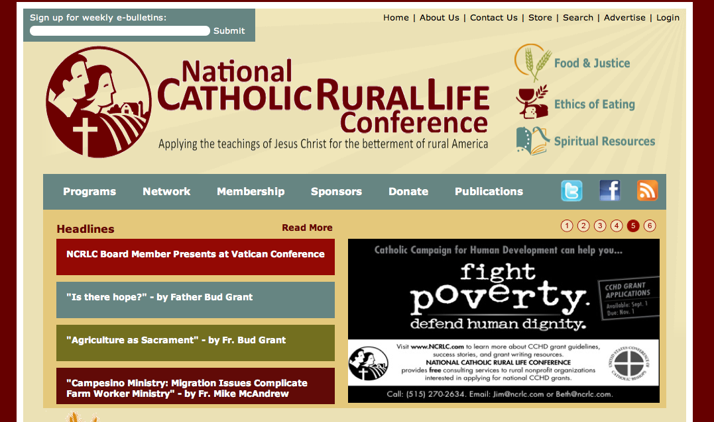
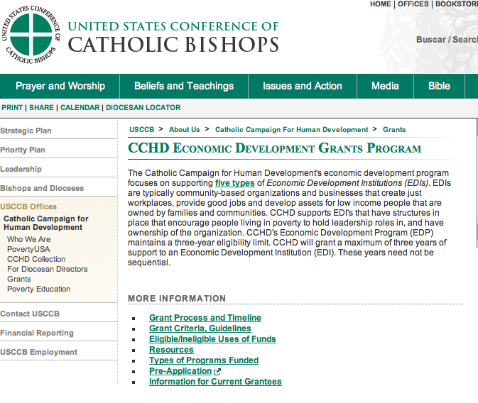
Reference Page - Links
NCRLC homepage
CCHD resources/success stories at NCRLC
CCHD homepage (USCCB site)
Application process, policies & timeline
General information, grant guide, trainings, contacts
Economic Development program details

